Slide 1

WEEDER T6 360

Slide 2
Motivation
Agriculture is the largest sector in India.
Weed removing is a major issue.
As weeds destroy the crop’s life span and quality, it is necessary to remove and eliminate them.
India spends around 16,250 crores on weed removal and other related activities.

Slide 3
Problem
Weeds are unwanted plants that have a disastrous effect on the crops. It competes for:
i)Sunlight
ii)Space
iii)Water
iv)Attracts insects and diseases
It is essential to remove them to prevent damages to crops.

Slide 4
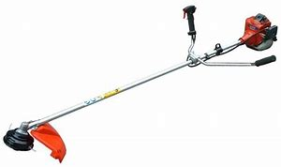
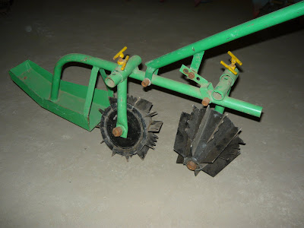
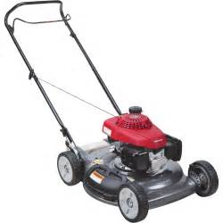
Products in the Current Market

Slide 5
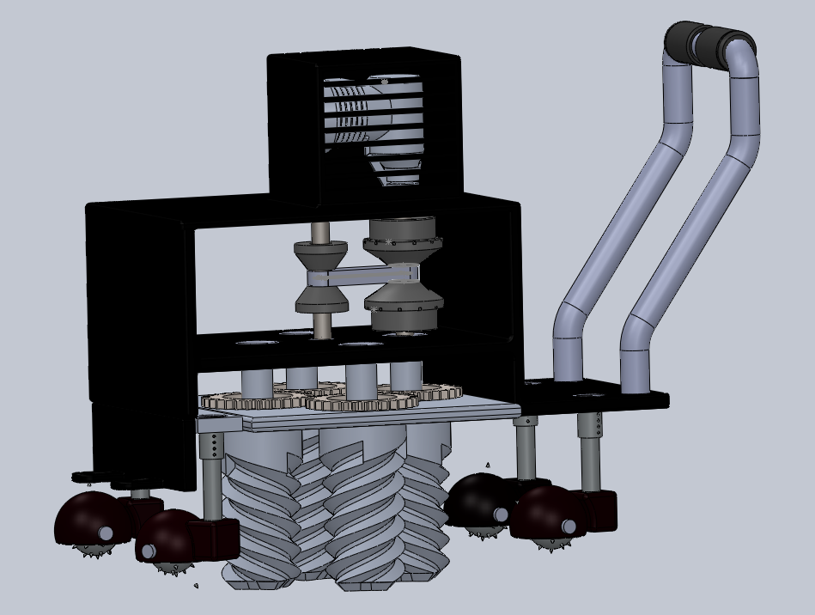
Weeder T6 360

Slide 6
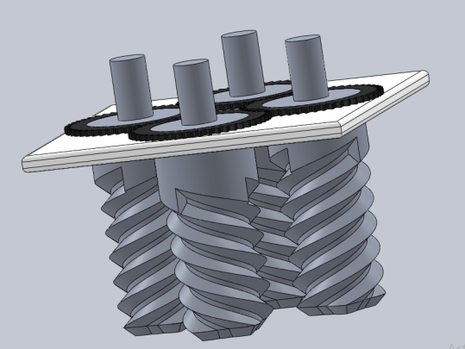
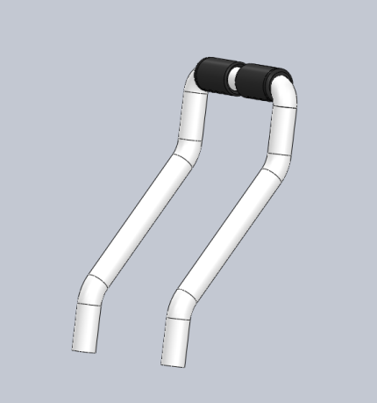
Subsystems
CUTTING TOOL
HANDLE

Slide 7
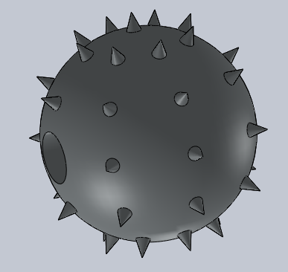
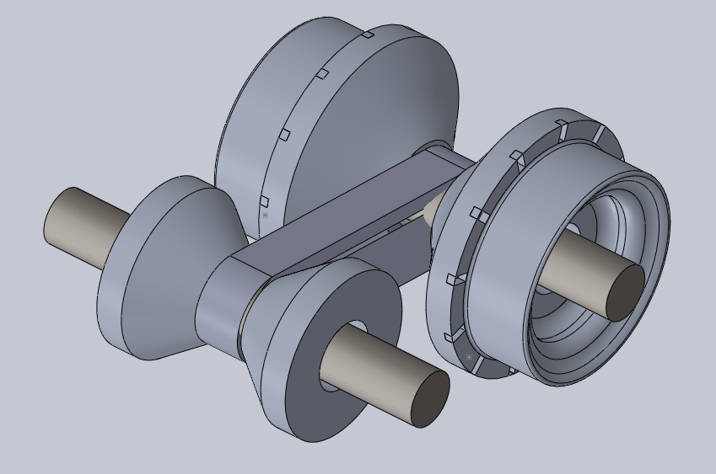
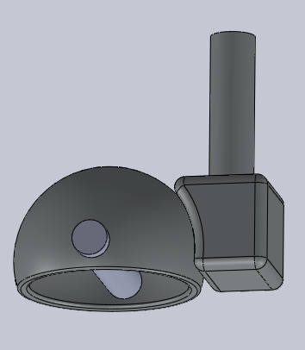
Subsystems
Castor Wheel Transmission System

Slide 8
Advantages
Our weed remover can
i) remove the weeds by it’s roots.
ii) has the ability to be maneuvered in all directions.
iii) cover more area in an efficient way.
iv) be easily handled with less effort.
v) soil tilling

Slide 9
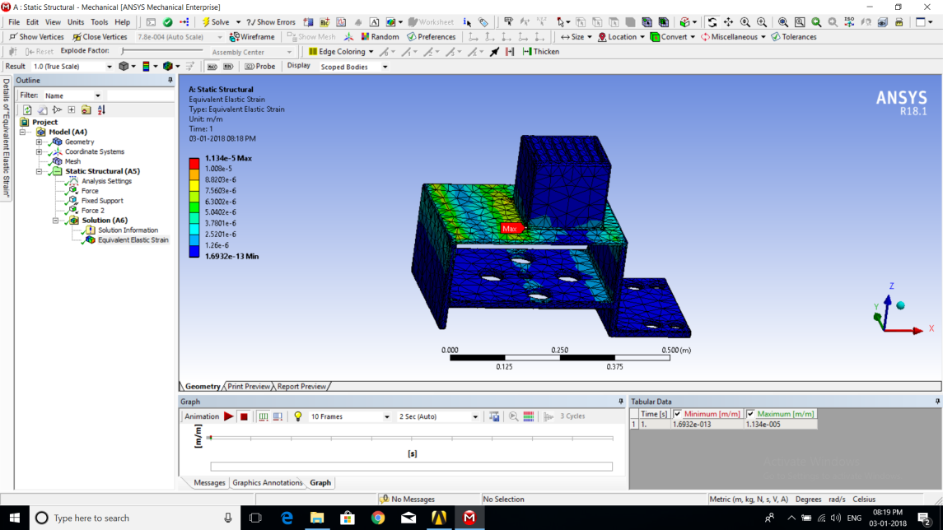
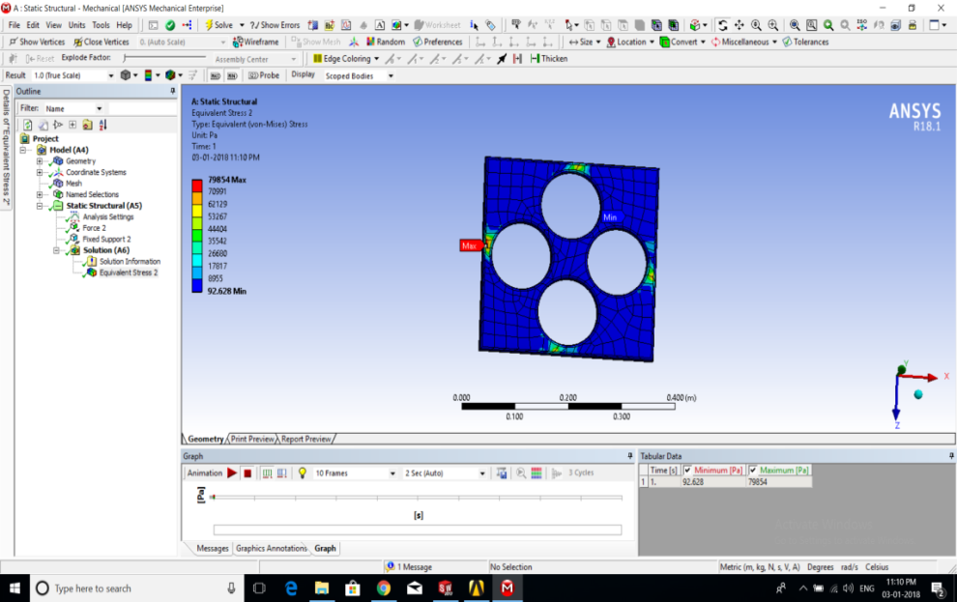
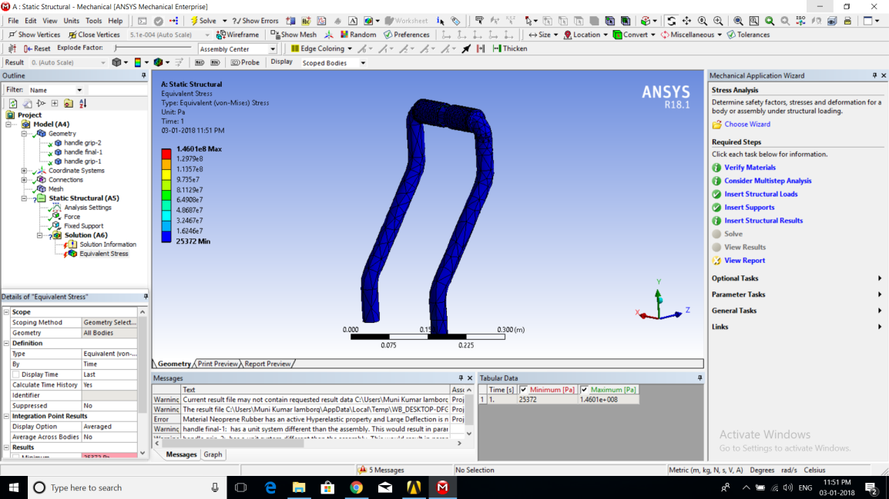
Analysis

Slide 10
Materials Used
CUTTING BLADE - Al 2014 T-6 grade alloy
PLATFORM - Al 6061 T-6 Grade
CASTOR WHEEL - AISI 4140 Chrome –Molybdenum High Tensile Steel
ENGINE SHAFT - 20Mn-Cr5 STEEL
HANDLE - Carbon fiber

Slide 11
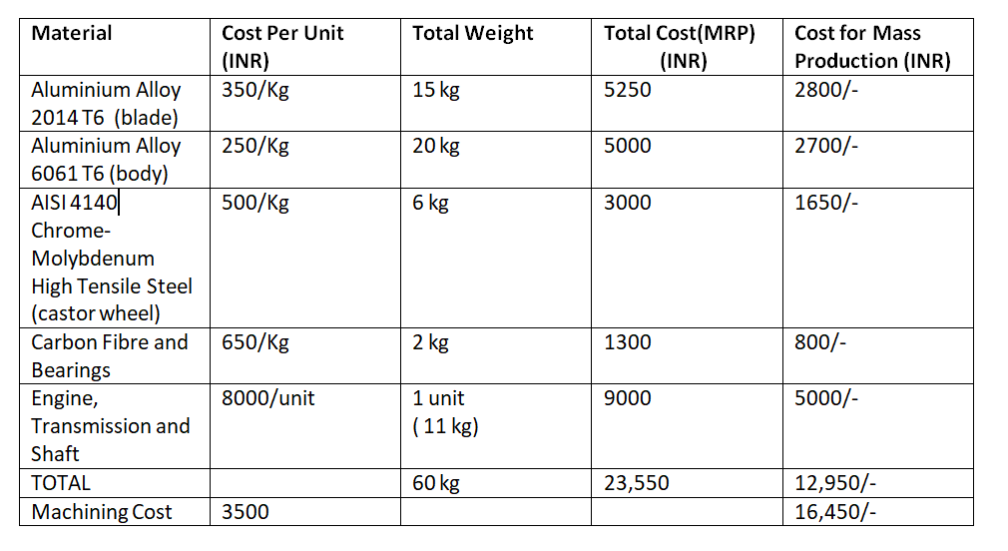
Cost

Slide 12
Scope of Improvement
Attachment of circular blade to remove stems of grown weeds.
More compact design.
Decrease the overall weight.
Wheels can be altered to track a linear motion.
Motors instead of engines to make a eco friendly product.

Slide 13
Conclusion
The designed model proves to be an effective and cost efficient alternative to the existing weed removing equipments .
This model contains very few moving and controllable parts and thus does not require the farmer to have a lot of prior knowledge.
Hence a successful alternative weed remover has been designed.

